Slide 1
RS Flip Flops
Benchmark Companies Inc
PO Box 473768
Aurora CO 80047

Slide 2
Flip Flops
A flip-flop remembers to which state it was previously set. It effectively memorizes the data it is given.

Slide 3

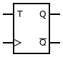

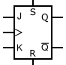
RS Flip-Flops
A flip-flop is a digital logic circuit, whose basic function is memory. It is capable of storing a single bit of binary data.

Slide 4
RS Flip-Flops
There are several basic types of flip-flops; the latch or RS flip flop, the T type, the D type and the JK flip flop.

Slide 5
RS Flip-Flops
Let’s start with the simplest, the latch, also called a set-reset or RS flip-flop. This is the simplest form of binary storage element. The symbol shown is used to represent this type of flip-flop.

Slide 6
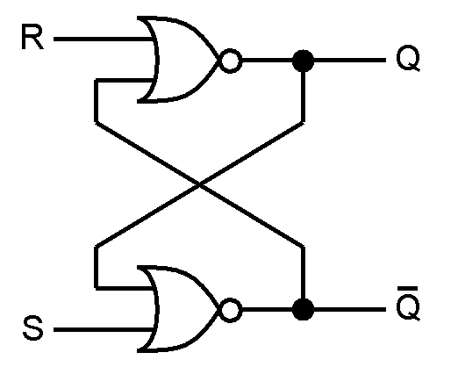
RS Flip-Flops
The most fundamental latch is the simple SR latch (or simple SR flip-flop), where S and R stand for Set and Reset.
Reset
Set

Slide 7
RS Flip-Flops
It can be constructed from a pair of cross-coupled NOR (negative OR) logic gates.
NOR Gates

Slide 8
RS Flip-Flops
The stored bit is present on the output marked Q.
Q

Slide 9
RS Flip-Flops
The compliment to Q is Q’ stored at the other output.
Q’

Slide 10
RS Flip-Flops
Normally, in storage mode, the S and R inputs are both low, and feedback maintains the Q and Q’ outputs in a pre-existing state (X), with Q’ the complement of Q.
R
S
Q
Q’
0
0
X
X

Slide 11
RS Flip-Flops
If S (Set) is pulsed high while R is held low, then the Q output is forced high, and stays high when S returns low.
R
S
Q
Q’
0
0
X
X
0
1
1
0

Slide 12
RS Flip-Flops
If R (Reset) is pulsed high while S is held low, then the Q output is forced low, and stays low when R returns low.
R
S
Q
Q’
0
0
X
X
0
1
1
0
1
0
0
1

Slide 13
RS Flip-Flops
The R = S = 1 combination is called a restricted combination. As both NOR gates then output zeros,
it breaks the logical equation Q = not Q.
R
S
Q
Q’
0
0
X
X
0
1
1
0
1
0
0
1
1
1
0
0

Slide 14
RS Flip-Flops
The table now illustrates the state of Q and Q’ as a result of the inputs R and S
R
S
Q
Q’
0
0
X
X
0
1
1
0
1
0
0
1
1
1
Restricted

Slide 15
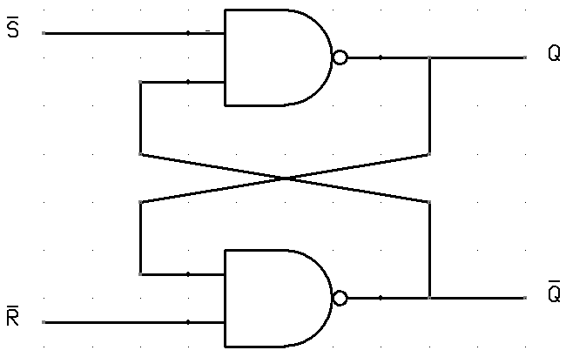
RS Flip-Flops
RS Flip Flops can be built using NAND gates
R
S
Q
Q’
0
0
0
1
1
0
1
1

Slide 16
RS Flip-Flops
Set and Reset now becomes active low signals, denoted S and R respectively.
R
S
Q
Q’
0
0
0
1
1
0
1
1

Slide 17
RS Flip-Flops
R=S=1 now represents the pre-existing State
R
S
Q
Q’
0
0
0
1
1
0
1
1
X
X

Slide 18
RS Flip-Flops
When S is low and R is High, Q is now High.
R
S
Q
Q’
0
0
0
1
1
0
1
0
1
1
X
X

Slide 19
RS Flip-Flops
When R is low and S is High, Q is now Low.
R
S
Q
Q’
0
0
0
1
0
1
1
0
1
0
1
1
X
X

Slide 20
RS Flip-Flops
When R=S=0 is combination is called a restricted combination. As both NAND gates then output = 1,
it breaks the logical equation Q = not Q.
R
S
Q
Q’
0
0
Restricted
0
1
0
1
1
0
1
0
1
1
X
X

Slide 21
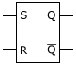
RS Flip-Flops
Summary: RS Flips flops can be made with NOR gates or NAND gates. NOR gates use Positive Logic Levels. NAND gates use Negative Logic Levels
R
S
Q
Q’
R
S
Q
Q’
0
0
X
X
0
0
Restricted
0
1
1
0
0
1
0
1
1
0
0
1
1
0
1
0
1
1
Restricted
1
1
X
X

Slide 22
End of Lesson

